Slide 1
Interdisciplinary Math communication skills
Honors module
Dr. Nicos Starreveld

Slide 2
Program for today
Intended Learning Objectives
Review of the material about the poster
  Intended learning objectives
  The poster
The article
  Intended learning outcomes
  Structuring the article and the SCQA method
Pauze
Assignment on SCQA - Pauze
Writing the article
Homework assignments
10 minutes
15 minutes
20 minutes
15 minutes
45 minutes – 15 minutes
30 minutes
15 minutes

Slide 3
Intended learning objectives
Gain experience in working in an interdisciplinary team and in doing interdisciplinary research.
Apply mathematics on a problem from a different discipline.
Explain how the terminology used in mathematics and the terminology used in other sciences relate to each other.
Explain your research and results, written or orally, to a broader audience.
Determine the structure and the content of a poster/article that is suitable for a given target audience.

Slide 4
Intended learning objectives of this training
Gain experience in working in an interdisciplinary team and in doing interdisciplinary research.
Apply mathematics on a problem from a different discipline.
Explain how the terminology used in mathematics and the terminology used in other sciences relate to each other.
Explain your research and results, written or orally, to a broader audience.
Determine the structure and the content of a poster/article that is suitable for a given target audience.

Slide 5
Part I - Recap from the poster at the NMC
Intended learning objective
Explain how the terminology used in mathematics and the terminology used in other sciences relate to each other.
People from different disciplines don’t always use the same terminology.
For example:
Configuration model < - > uniform graph with fixed degrees;
Phase transition < - > gelation point;
Giant component < - > polymer.

Slide 6
Recap from the poster at the NMC
In order to explain interdisciplinary research it is important to take this under consideration.
Second intended learning objective
Determine the structure and the content of a poster that is suitable for a given target audience.
After having a clear view on the intended target group it is important to agree on a suitable structure for the poster.

Slide 7
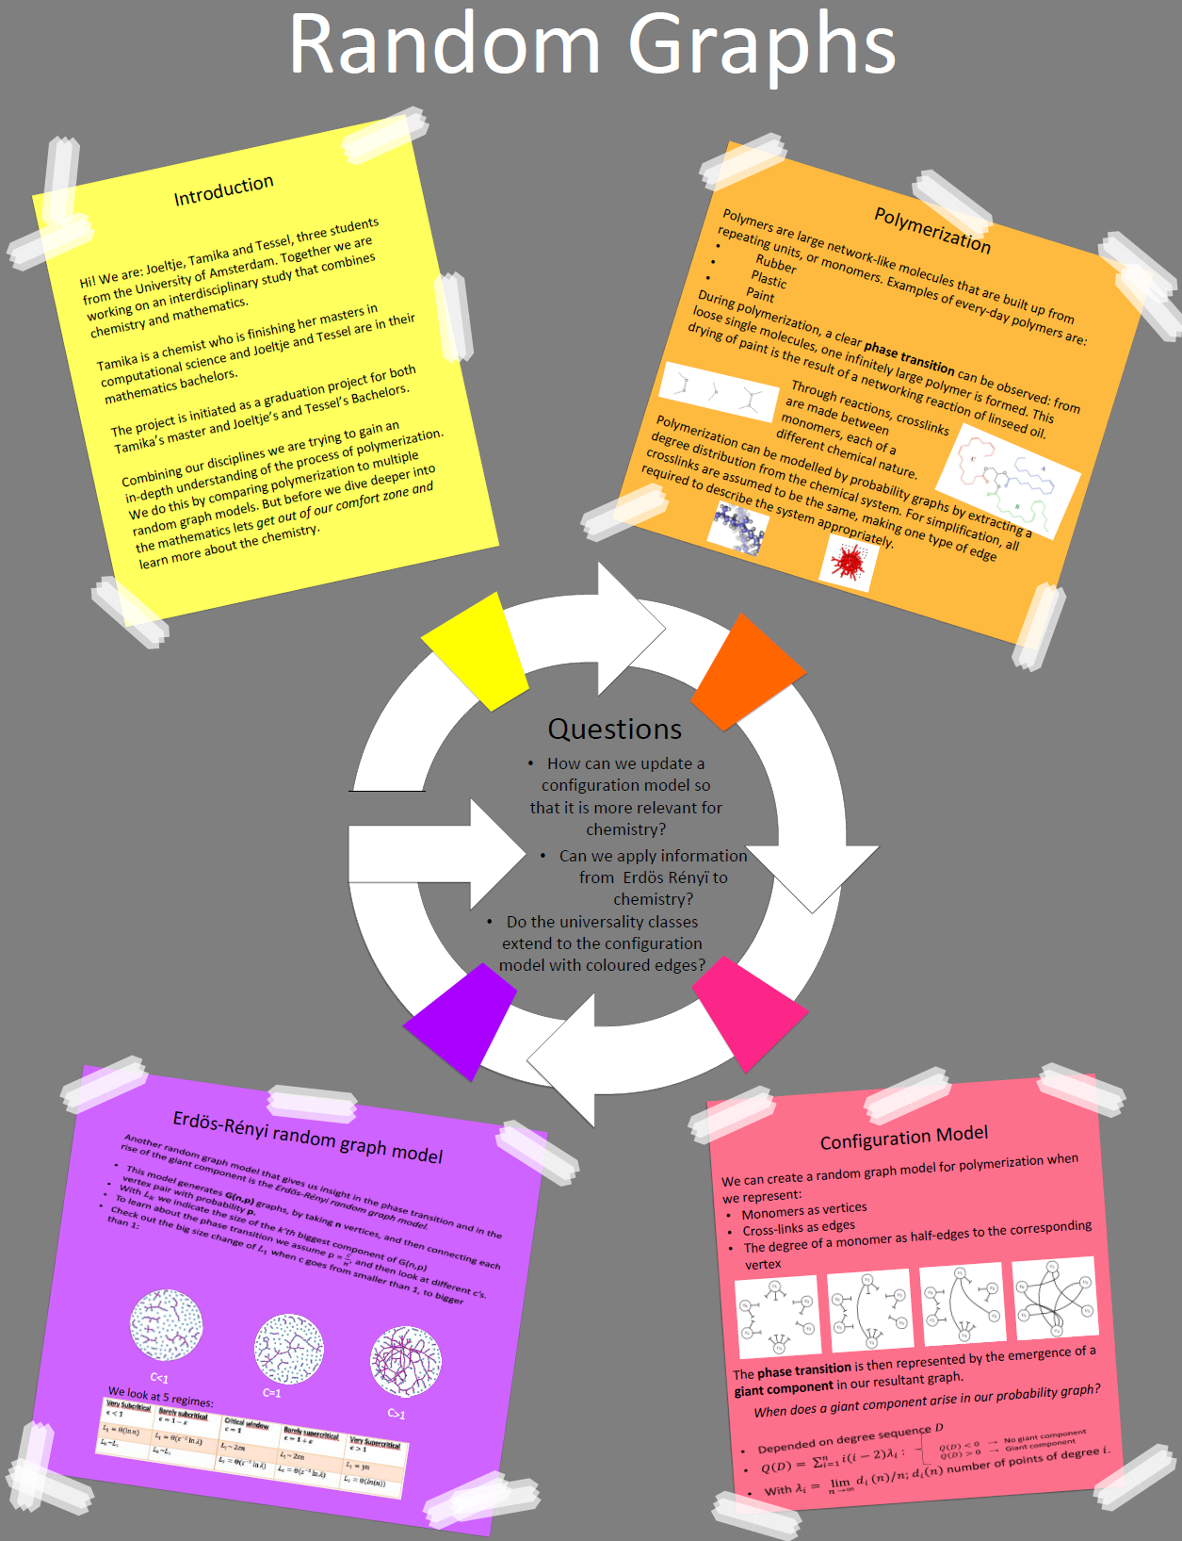
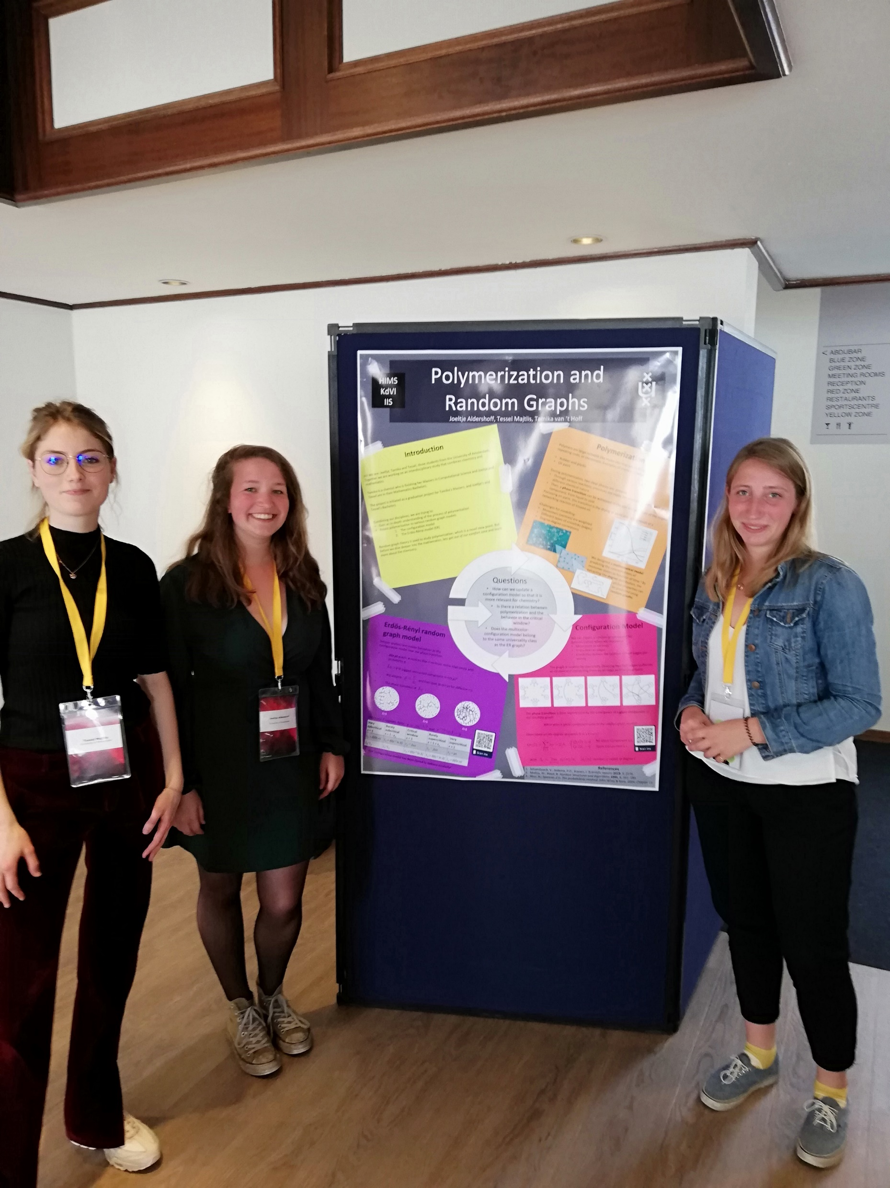
Recap from the poster at the NMC

Slide 8
Part II - Article
In this session we will focus on the following learning objectives
Explain how the terminology used in mathematics and the terminology used in other sciences relate to each other. (covered)
Determine the structure and the content of an article that is suitable for a given target audience.
Explain your research and results, written to a broader audience.

Slide 9
Article – Structure
Determine the structure and the content of an article that is suitable for a given target audience.
We will learn how to use the SCQA method to structure and article.
As a exercise we will have a look at some written articles.
As a second exercise will have a look at a TED Talk.
Take home assignment on SCQA.

Slide 10
The SCQA method
People need structure to process information
If you don’t present that structure -> people will make their own structure
  This may lead to misinterpretation or losing the focus.
The SCQA method is a tool to define the elements of your story structure.
It originates from the Pyramid method (see references at the end).

Slide 11
The SCQA method
Acts as a starting point. You present facts and information that is broadly acceptable.
S Situation
C Complication
Q Question
A Answer
Acts as a motivation. You present the complications, problems and opportunities that arise from the situation.
Formulate the main questions. Here you make concrete questions that arise from the complication about how these can be resolved.
Main message of the article. You give the answers to the questions posed.

Slide 12
The SCQA method - Example
S Situation
C Complication
Q Question
A Answer
A country in the EU is unable to repay its debts.
European economies are connected to other economies in the Euro zone.
This implies that this country would default other countries may also follow.
How can the EU make sure that this country will not default while staying in the Euro zone?
Possible answer: Erase this country’s debt.
Possible answer: Remove this country from the Euro zone.
Possible answer: Some other viable plan.

Slide 13
Assignment – SCQA and articles
Take one of the following three articles and divide it in parts.
  Which part corresponds to Situation?
  Which part corresponds to Complication?
  Which are the Questions?
  Which are the given Answers?
Articles:
  How to plan Valentine’s day using a matching algorithm
  Drug dumping in the Netherlands; a gentle introduction to uncertainty and statistics.
  How the popular become even more popular

Slide 14

The SCQA method
S Situation
C Complication
Q Question
A Answer
Your message!

Slide 15
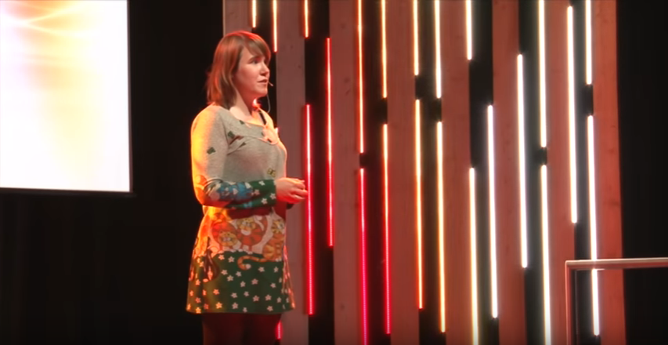
Assignment – SCQA and talks
Identify the SCQA in the following TED talk
Ionica Smeets, The danger of mixing up causality and correlation.
https://www.youtube.com/watch?v=8B271L3NtAw

Slide 16
References
The material on the SCQA method was developed from N. Starreveld based on a training provided by Analytic Story Telling.
The Pyramid Principle: Logic in Writing and Thinking (The pyramid principle), book written by Barbara Minto.

Slide 17
Writing the article
We will now focus on the last learning objective
Explain your research and results, written or orally, to a broader audience.
We have talked about structuring the article using the SCQA method.
Now we will focus on writing the actual article.

Slide 18
Writing the article - Assignment
Identify in the following five short articles two things you like and two things you don’t like.
Hilbert's Nullstellensatz
De homogeniteit van de Hilbertkubus
Large Deviations of Triangle Counts on Erdös-Rényi Random Graphs
Neurale netwerken
Spectrale grafentheorie

Slide 19
Writing the article
In order to write the article we will chose a point to focus on
Our focus point is
Is the general line of the story comprehensible from the beginning until the end? Does the reader get an answer on the moment he/she poses a question?
And we will start practicing with writing

Slide 20
Homework Assignments
Fill in the SCQA form for your article (deadline 24 April)
Write a first version of the article based on the SCQA method (deadline 22 May)
In writing the article use the following two writing tips:
1. Write in paragraphs. Each paragraph is a conceptually independent unit.
2. Chose a clear structure for the article (see SCQA assignment).

